Slide 1

THE IA
IA – 2 – Criteria A

Slide 2
CRITERIA A – PROBLEM SPECIFICATION
300 words
Criteria A has THREE parts
Problem Scenario
Success Criteria
Computational Context

Slide 3
PROBLEM SCENARIO
The problem scenario is a clear description of the problem including its measurable solution requirements
Description should relate directly to the problem, whether this be in the world around us, other fields of knowledge, or a current issue in computing

Slide 4
SUCCESS CRITERIA
You guys know the drill with success criteria
Measurable outcomes derived from the solution requirements
Indicate successful development of the product

Slide 5
COMPUTATIONAL CONTEXT
Computational context – the specific area of computing that is selected to be used in the solution

Slide 6
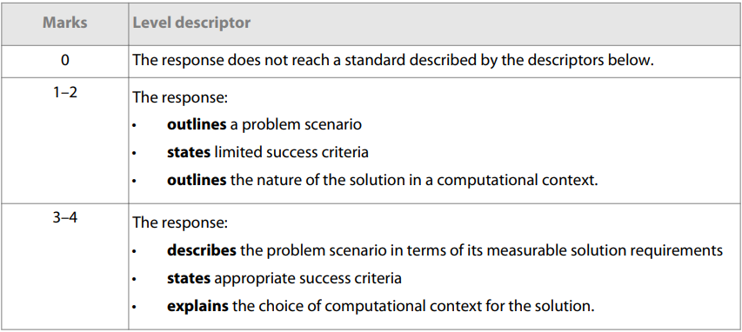
MARKSCHEME
Markscheme

Slide 7
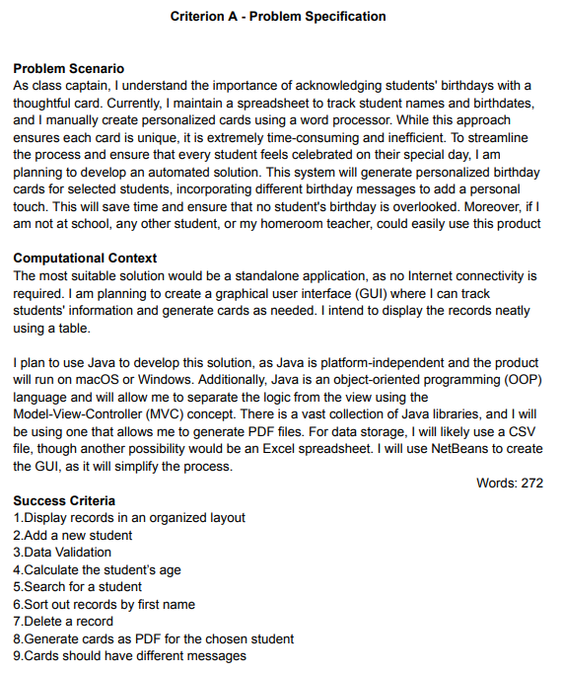

LET’S DO SOME MARKING
What do we think this got?

Slide 8
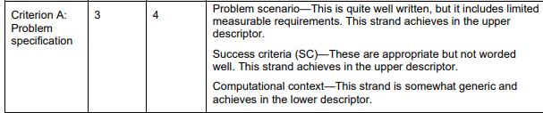
LET’S DO SOME MARKING
What do we think this got?

Slide 9
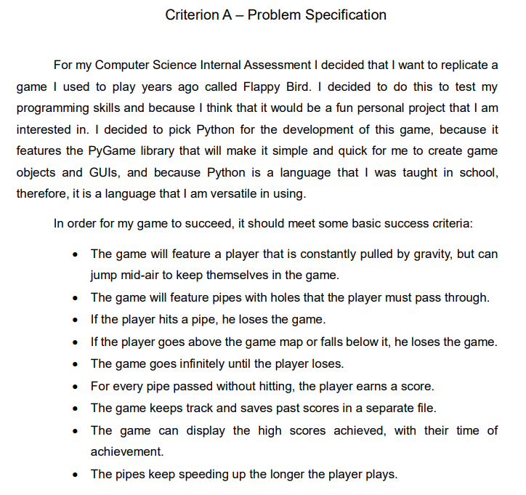
LET’S DO SOME MARKING
How about this one?

Slide 10

LET’S DO SOME MARKING
How about this one?

Slide 11
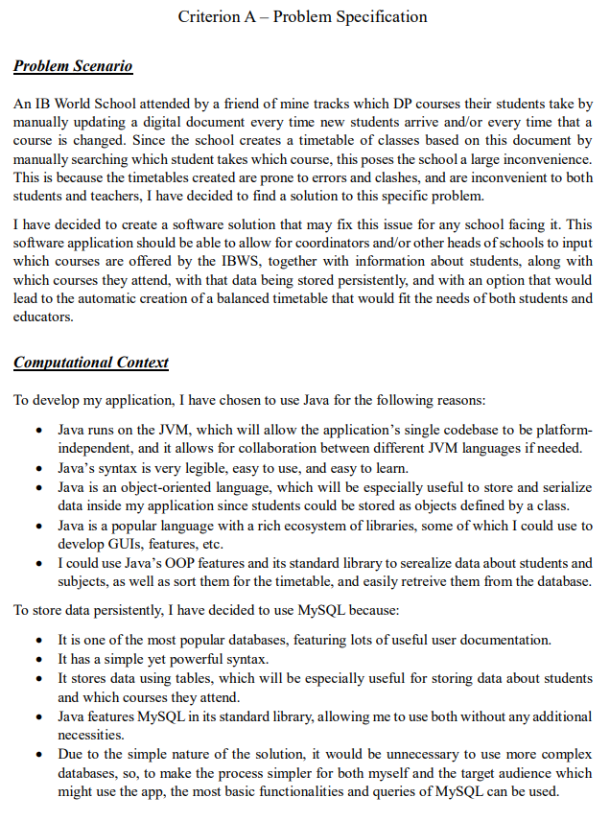
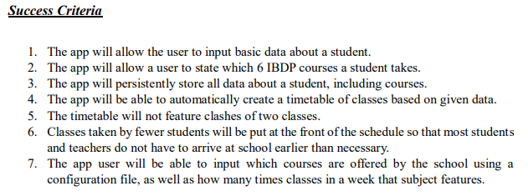
LET’S DO SOME MARKING
Finally, this one

Slide 12
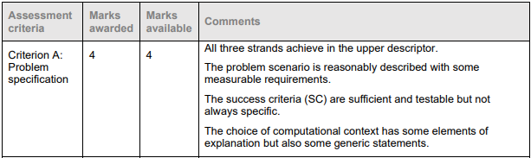
LET’S DO SOME MARKING
Finally, this one

Slide 13
LET’S DO SOME MARKING
Now, you might notice this one is above the recommended 300 words, closer to 500
yeah

Slide 14
“WORD COUNT”
You cannot exceed 2000 words total
But, you can shuffle the recommended word count per section around. You can have a slightly shorter Criteria C to have a slightly longer criteria A.
It seems difficult to score full marks for criteria A without using more than 300 words, so use slightly more to make sure your ideas come across well
It is your first impression after all

Slide 15
CRITERIA A - ASSIGNED
Check GitHub for the Criteria A document to know what to write and create for your presentation

